Slide 1



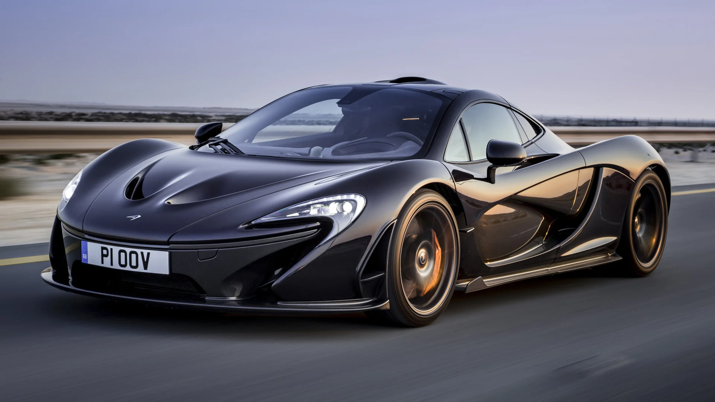







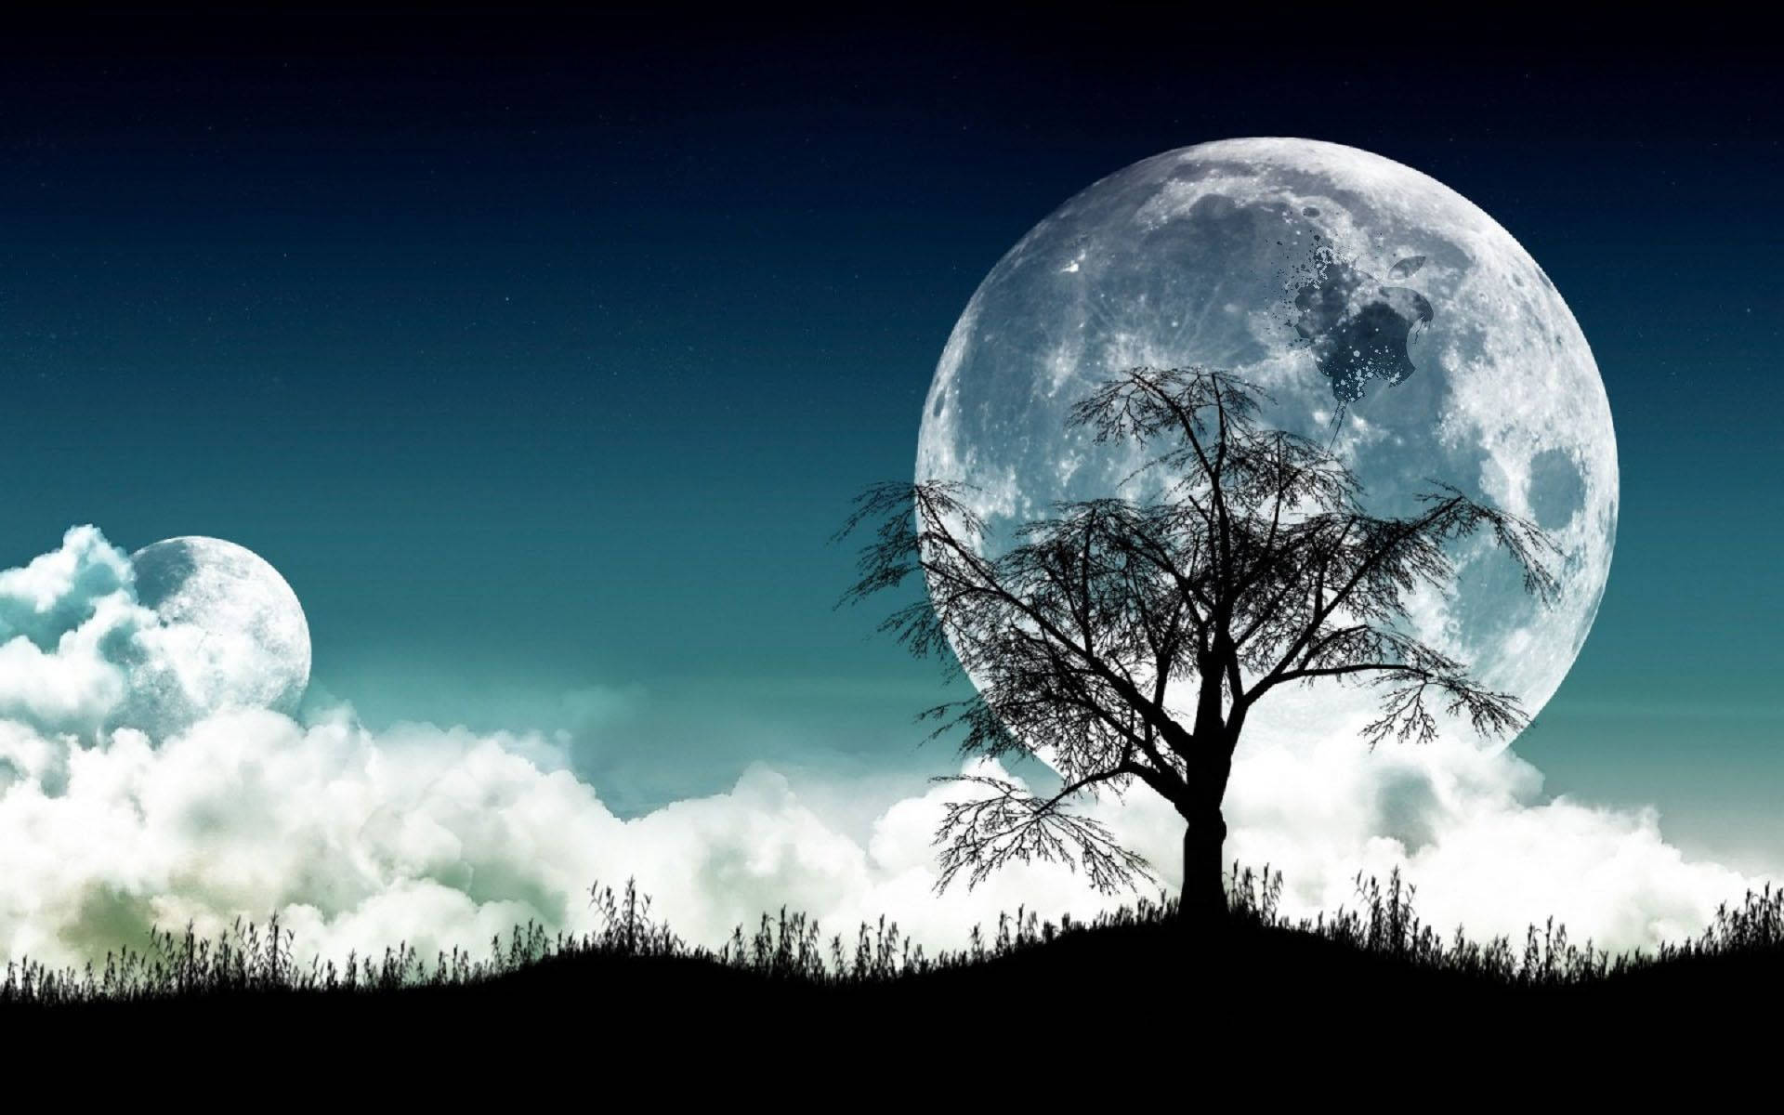




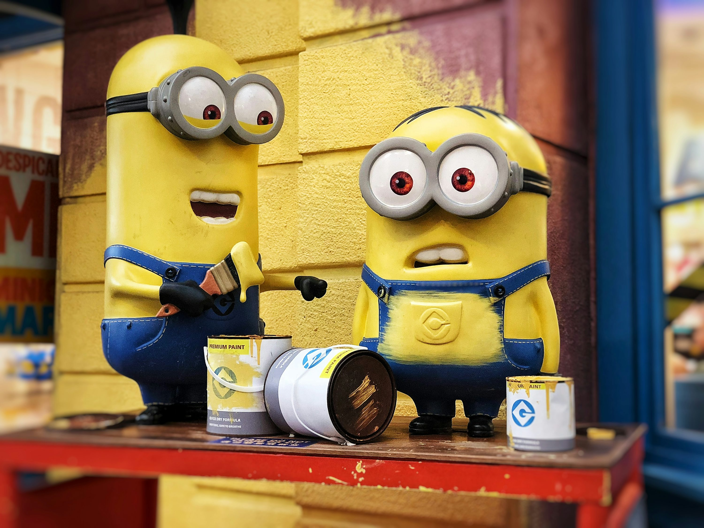










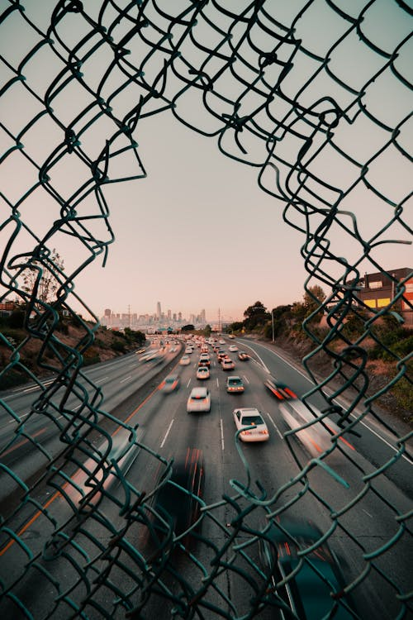
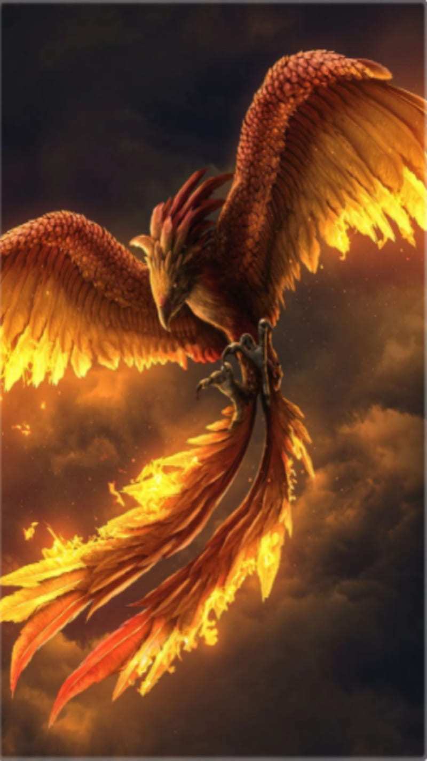
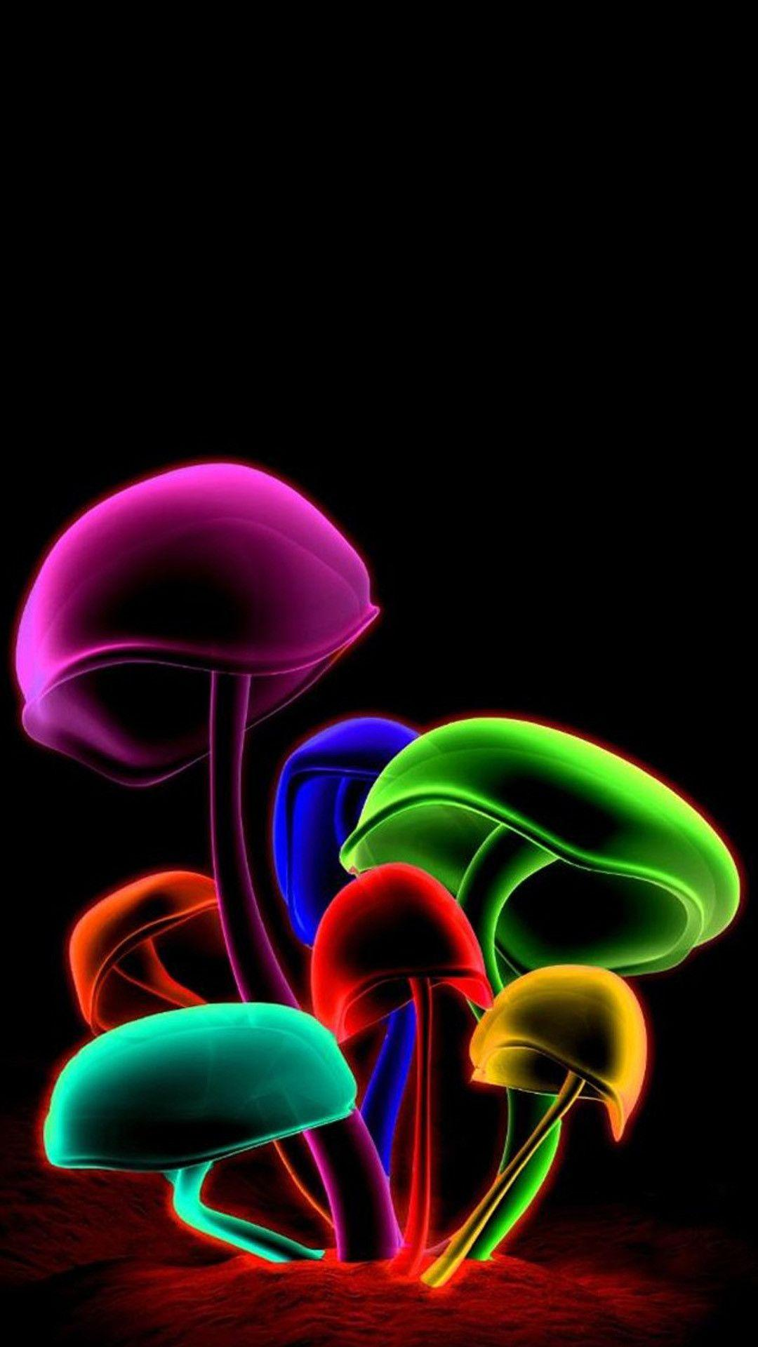





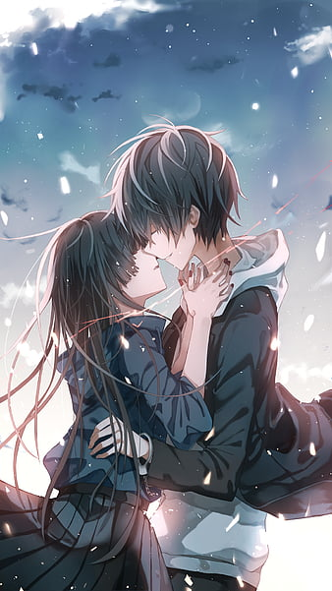












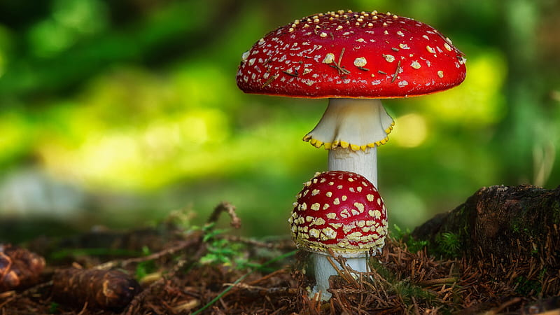

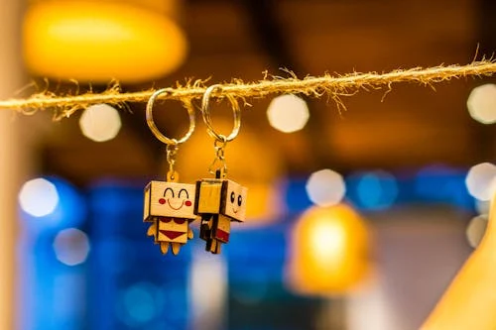


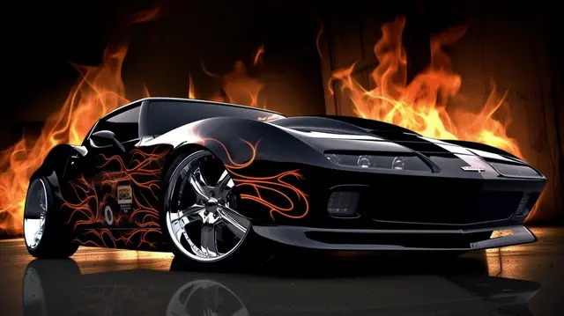














Slide 2

DEAR
FROM

Slide 3
DEAR
FROM

Slide 4
DEAR
FROM

Slide 5

DEAR
FROM

Slide 6


DEAR
FROM

Slide 7
DEAR
FROM

Slide 8
DEAR
FROM

Slide 9
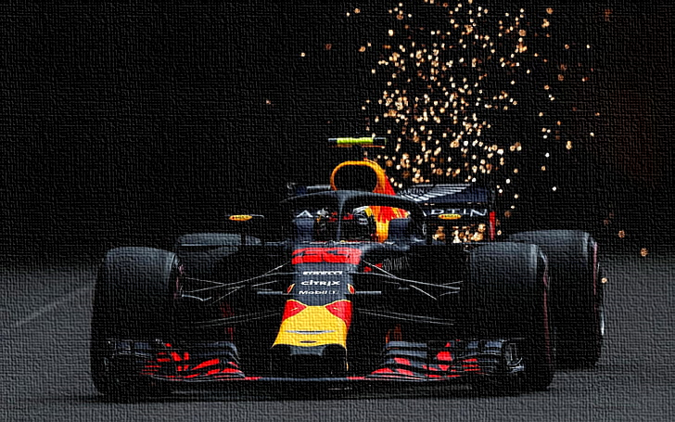
DEAR
FROM

Slide 10

DEAR
FROM

Slide 11
DEAR
FROM

Slide 12
DEAR
FROM

Slide 13

DEAR
FROM

Slide 14
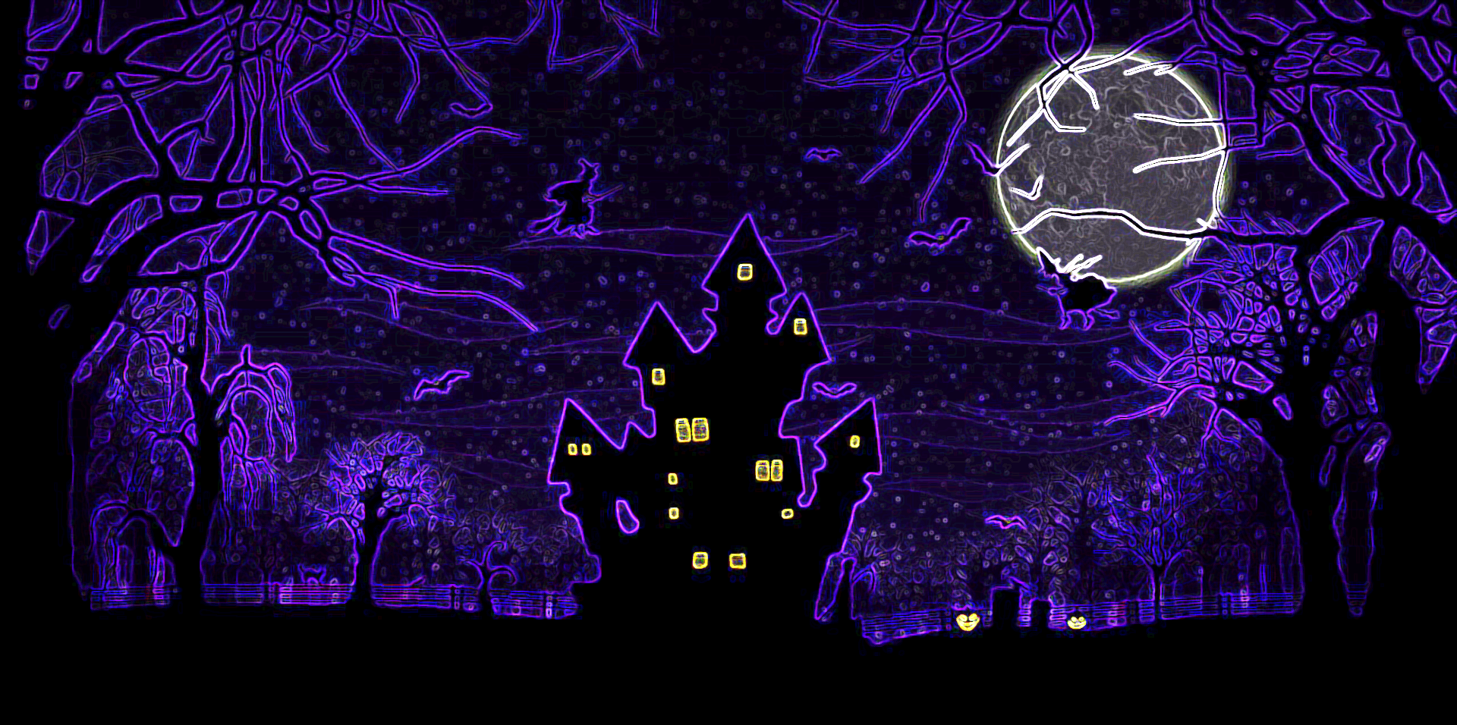
DEAR
FROM

Slide 15
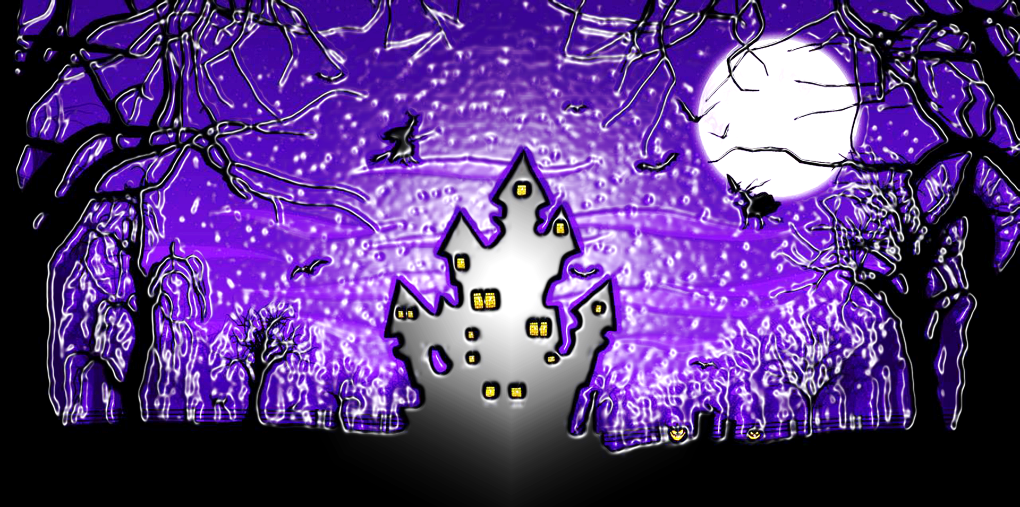
DEAR
FROM

Slide 16

DEAR
FROM

Slide 17

DEAR
FROM

Slide 18

DEAR
FROM

Slide 19

DEAR
FROM

Slide 20

DEAR
FROM

Slide 21
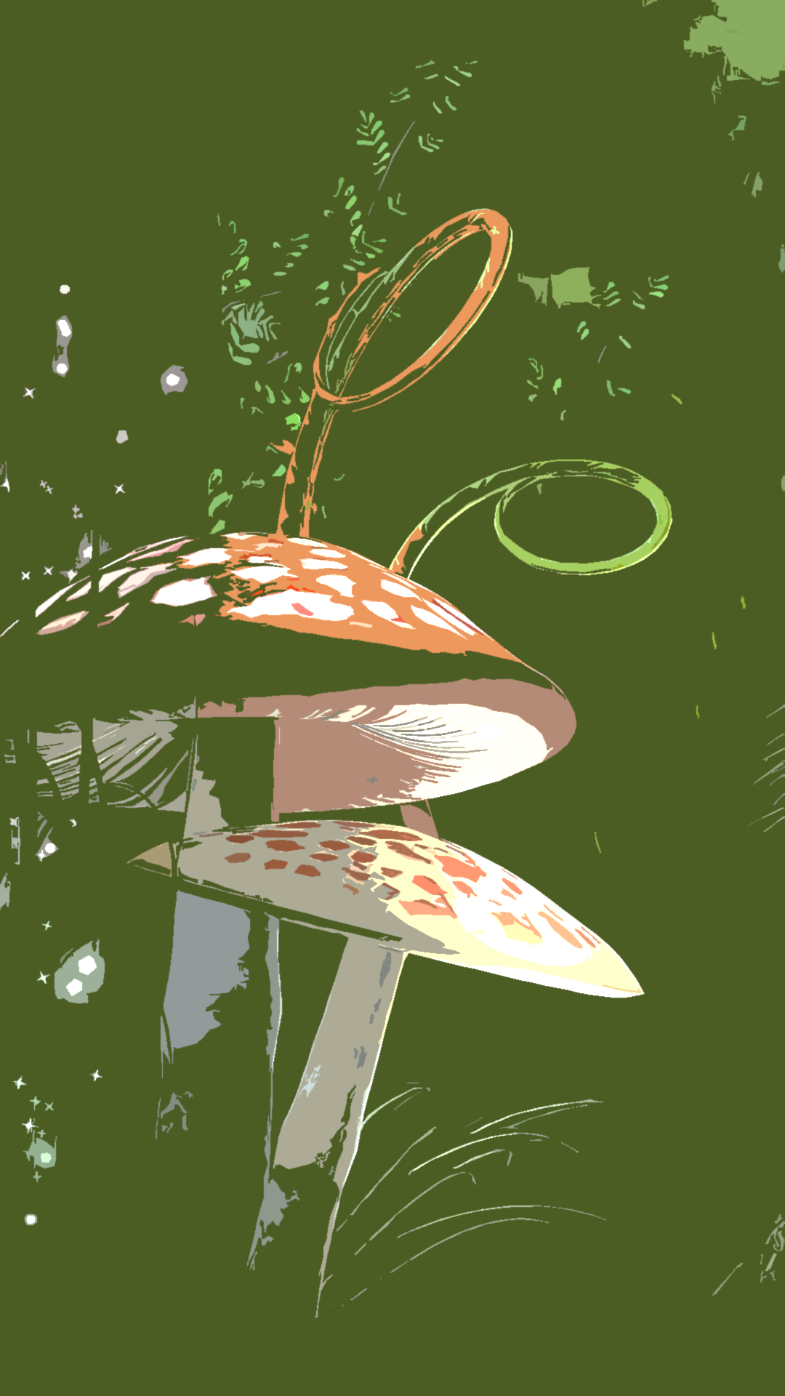
DEAR
FROM

Slide 22
DEAR
FROM

Slide 23
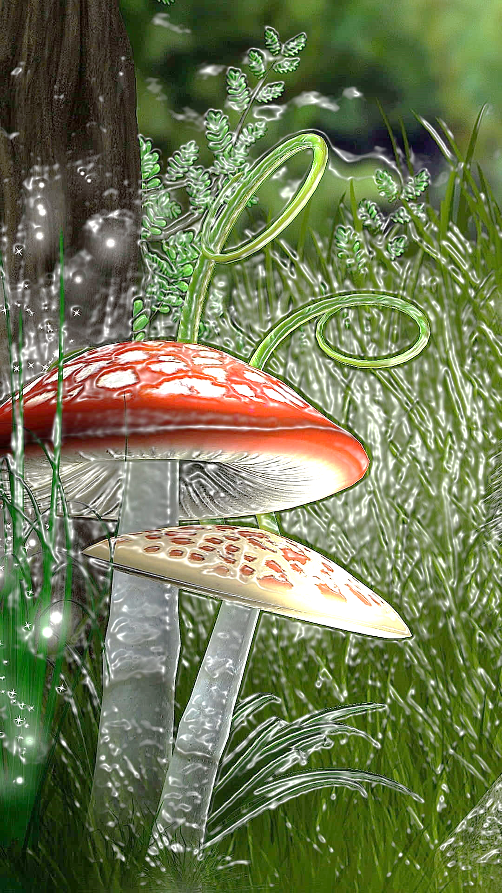
DEAR
FROM

Slide 24
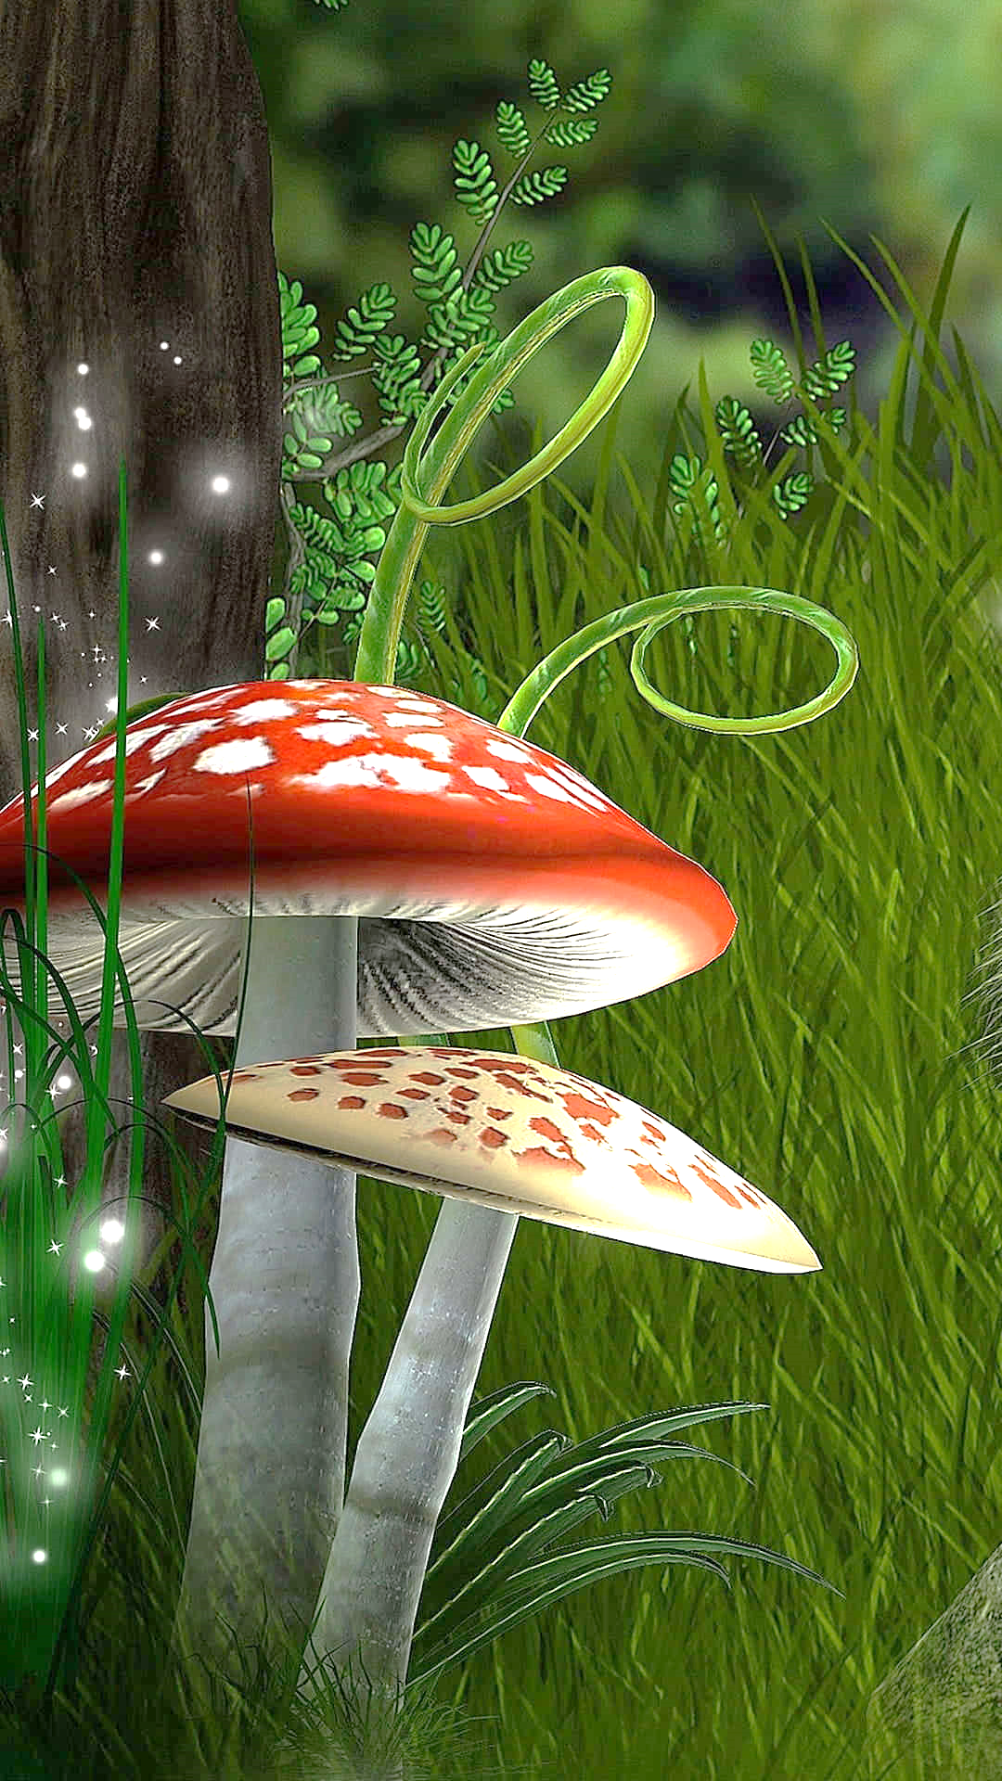
DEAR
FROM

Slide 25
DEAR
FROM

Slide 26
DEAR
FROM

Slide 27
DEAR
FROM

Slide 28

DEAR
FROM

Slide 29

DEAR
FROM

Slide 30
DEAR
FROM

Slide 31
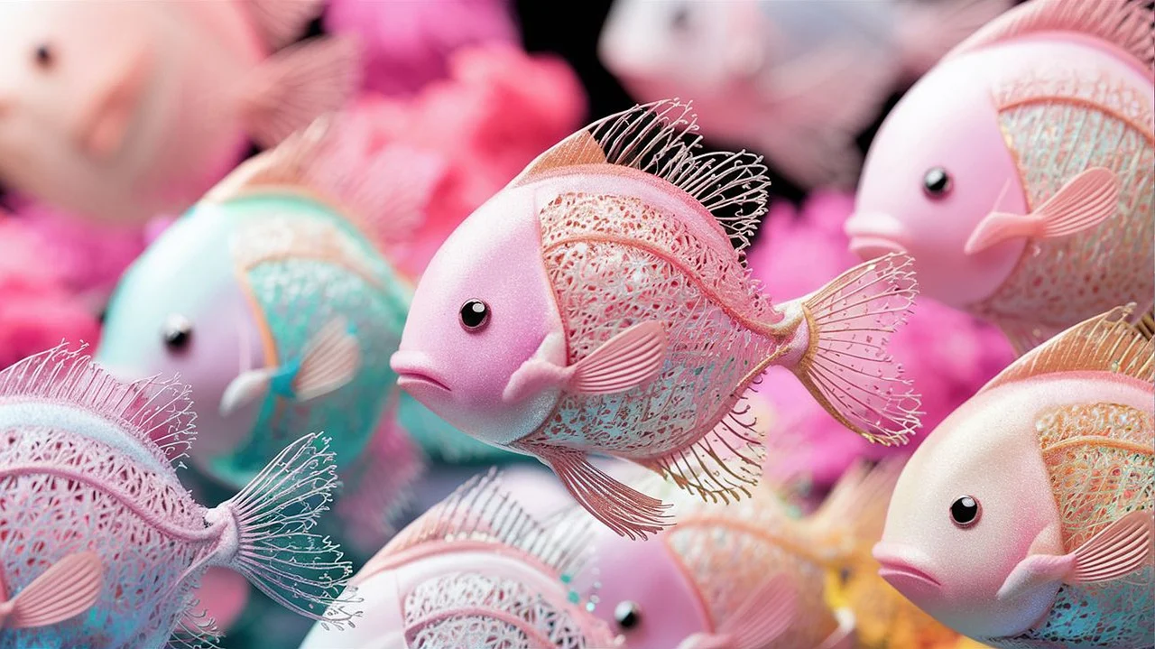
DEAR
FROM

Slide 32
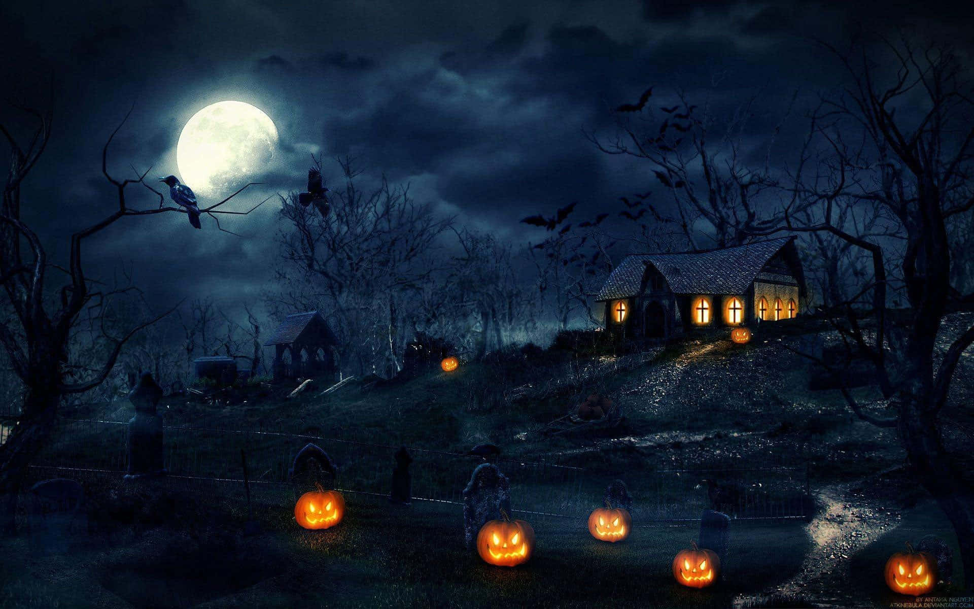
DEAR
FROM

Slide 33
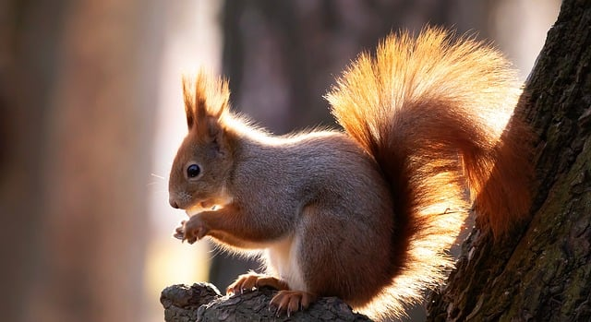
DEAR
FROM

Slide 34

DEAR
FROM

Slide 35

DEAR
FROM

Slide 36

DEAR
FROM

Slide 37

DEAR
FROM

Slide 38

DEAR
FROM

Slide 39

DEAR
FROM

Slide 40

DEAR
FROM

Slide 41

DEAR
FROM

